Slide 1
RADIO PROPAGATION THEORY
1 – Signals
2 – Wave propagation
3 – Antennas

Slide 2
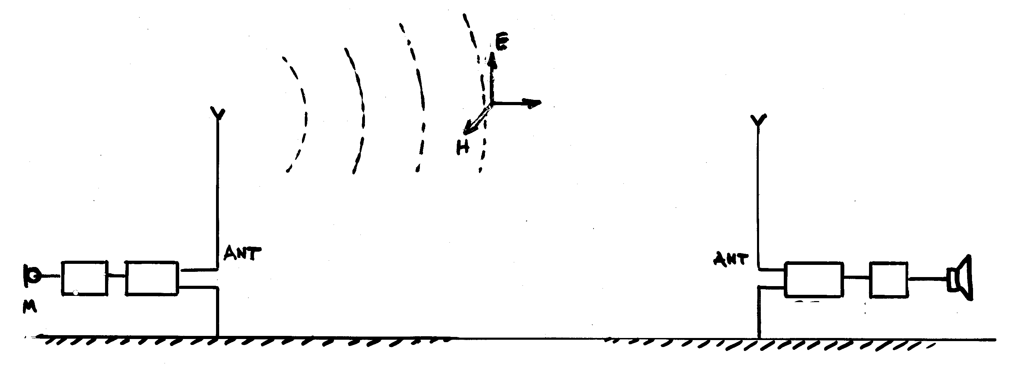
RADIO TRANSMISSION
EM Wave
Receiver
(2stages)
Transmitter
(2 stages)
modulator
demodulator
The carrier, high frequency signal acts as a transporter for the low frequency signal
sensor
actuator
amplifier
amplifier
Signals to be transmitted are often impossible to transmit directly as radiowaves due to their frequencies. Modulation is necessary to transmit the signal on a radio frequency called carrier. The information of the modulating signal is impressed onto the carrier. The carrier is modulated.

Slide 3
MODULATION
Modulation: periodic variation of the sinusoidal carrier by the modulating signal to be transmitted.The modulating signal is impressed onto the carrier.
The process of Modulation is not neutral for the spectrum. The spectrum is modified. (a way to represent a signal amplitude of fundamental and harmonics function of frequency)
The modulation of a carrier frequency generates a spectrum that must be taken into account for the bandwidth of circuits and interference protection.

Slide 4
KINDS OF MODULATION
Amplitude Modulation: the information is impressed onto the carrier wave by altering the amplitude of the carrier.
Frequency Modulation: the information is impressed onto the carrier wave by altering the frequency of the carrier.
Phase Modulation: a modulation form used by GPS where the phase of the carrier is reversed. (Phase fraction of wavelength expressed in degrees)
Pulse Modulation: A modulation form used in radar by transmitting short pulses followed by larger interruptions.

Slide 5
SPECTRUM
Any periodic signal may be expressed as the sum of sinusoidal signals: fundamental signal of frequency f and harmonic signals of frequency 2f, 3f, … nf.
It is then useful to know the two inseparable representations of a signal: amplitude as a function of time and amplitude of fundamental and harmonics as a function of their frequencies.
A signal is capable of being transmitted if the number of its harmonic components is limited because the circuits that are physically executable carry only the frequencies of a certain interval: their bandwith is limited.

Slide 6
SPECTRUM
Slow changing signal => narrow spectrum
Fast changing signal => wide spectrum
Periodic signal => spectrum of lines spaced 1/T apart
Modulated signal => the spectrum is translated around the carrier
Incoherent signal (noise or atmospheric interferences) => broad spectrum

Slide 7
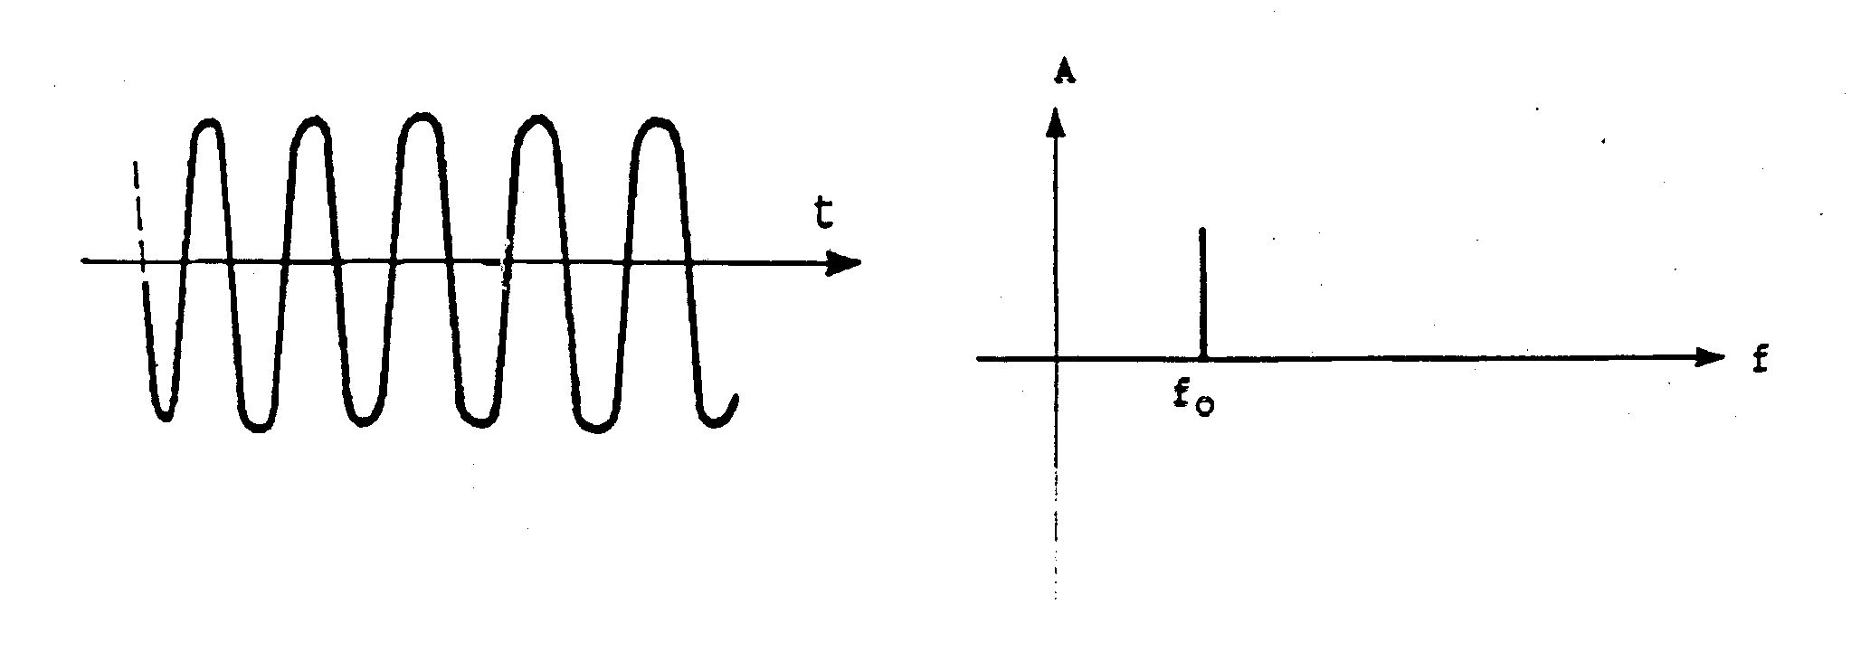
SINE SIGNAL SPECTRUM
Collection of usual spectrums.
Amplitude
just one component
Pure sinusoidal signal. Also CW = continuous wave.
The decomposition is obvious, the spectrum is obvious.
A line at the f0 frequency.

Slide 8
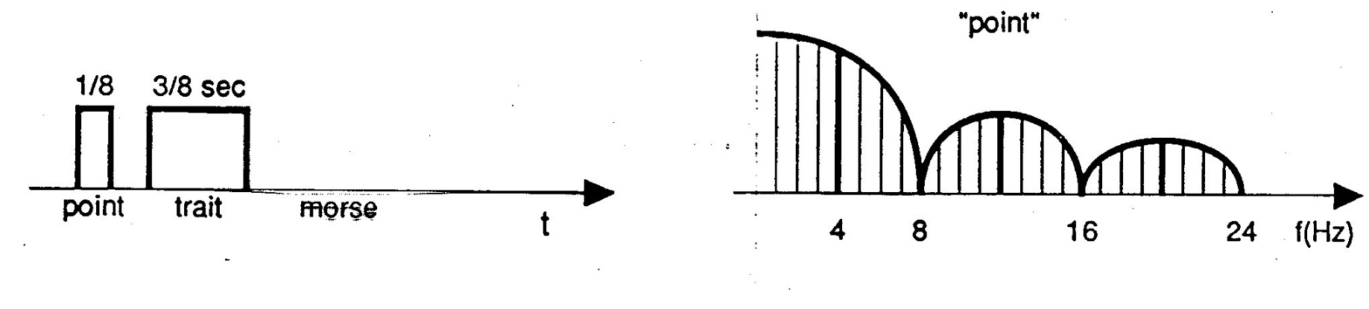
MORSE CODE SPECTRUM
Amplitude
the components
decrease quickly
Amplitude
Morse code or keying: Interrupting the signal to break it into dots and dashes. Duration of dot 1/8 s duration of dash 3/8 s.
Morse code spectrum: the spectrum is theoritically infinite but the amplitudes decreases with the frequency and the useful spectrum maybe reduced to the lines of frequency lower than 30 hz

Slide 9
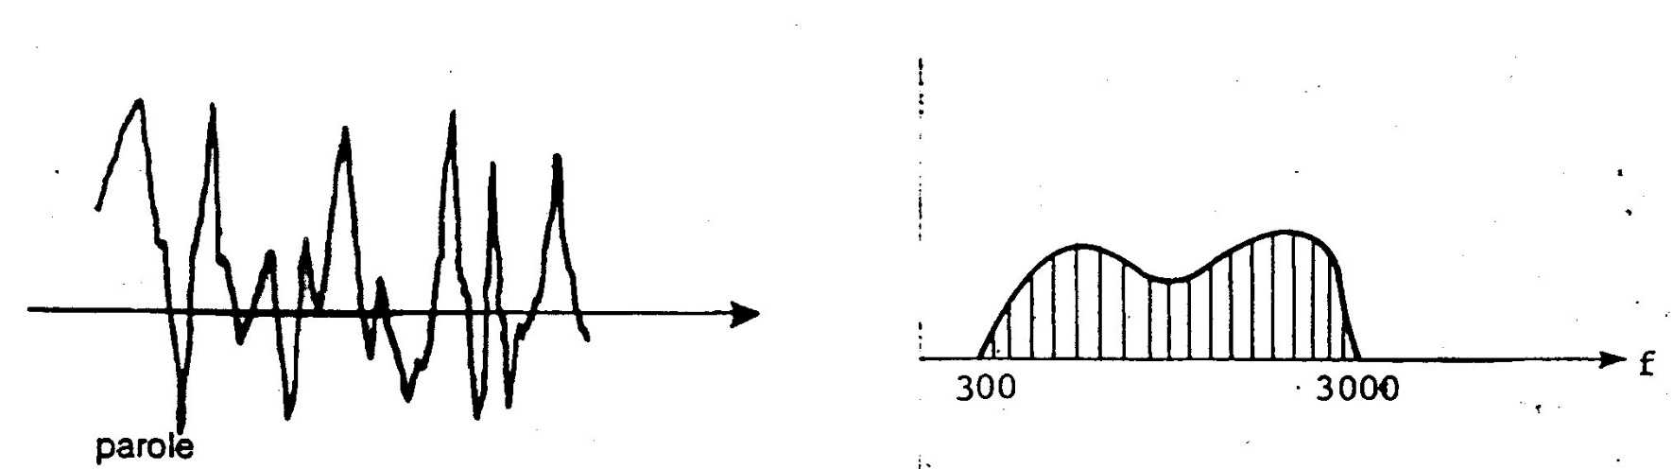
SPEECH SIGNAL SPECTRUM
Amplitude
Amplitude
t
The spectrum is limited with the 300hz 3000hz interval.
The line amplitude depends on the speaker and sound transmitted.

Slide 10
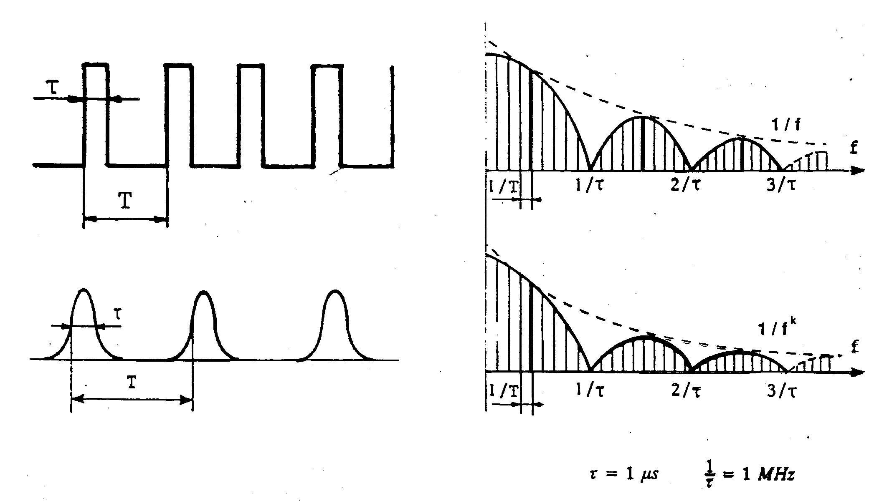
PULSE SIGNAL SPECTRUM
Fast signal: broad spectrum
Periodic rectangular pulses: spectrum of lines spaced 1/T apart, the spectrum is theoritically infinite but the amplitudes decreases with the frequency and the useful spectrum maybe reduced to the lines of frequency lower than 2/tau.
Slow signal: band limited spectrum
Rounded pulses: spectrum similar to the previous one but the attenuation according to the frequency is faster.
This spectrum is most favorable in term of useful bandwith.

Slide 11
RADIO SIGNALS CLASSIFICATION
A radio signal may be classified by three symbol in accordance with the ITU radio regulation (International Telecommunication Union): Example: A1A
First symbol indicates the type of modulation of the main carrier.
Second symbol indicates the nature of the signal modulating the main carrier
Third symbol indicates the nature of the information to be transmitted

Slide 12
MODULATION NON
Collection of usual spectrums (modulated signals).
Amplitude
Pure sinusoidal signal. Also CW = continuous wave.
The spectrum is obvious.
None modulation: NON.

Slide 13
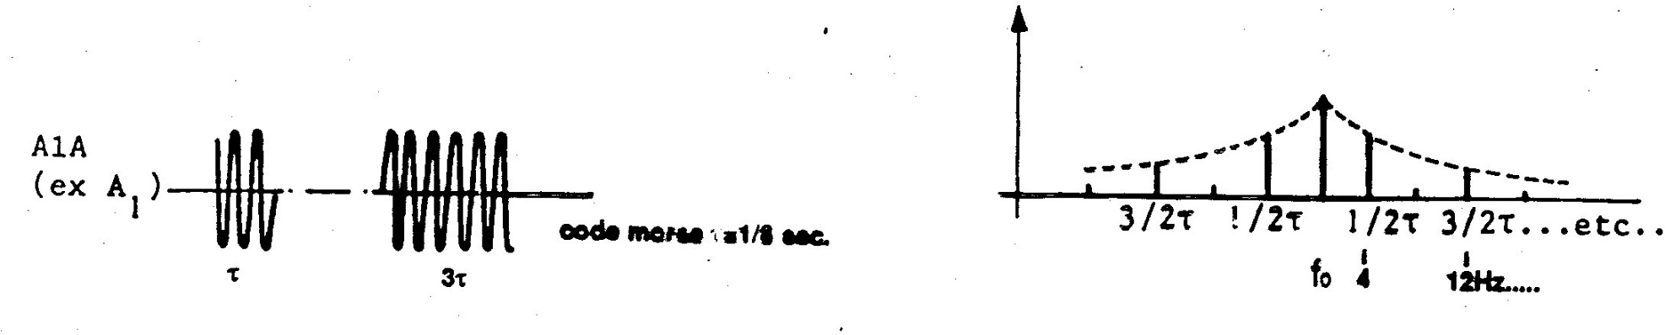
MODULATION A1A
Amplitude
Amplitude
f
A1A: Coded process. Signal interruption and restoration (according to the Morse code) (keying).
Interrupting the carrier wave to break it into dots and dashes.

Slide 14
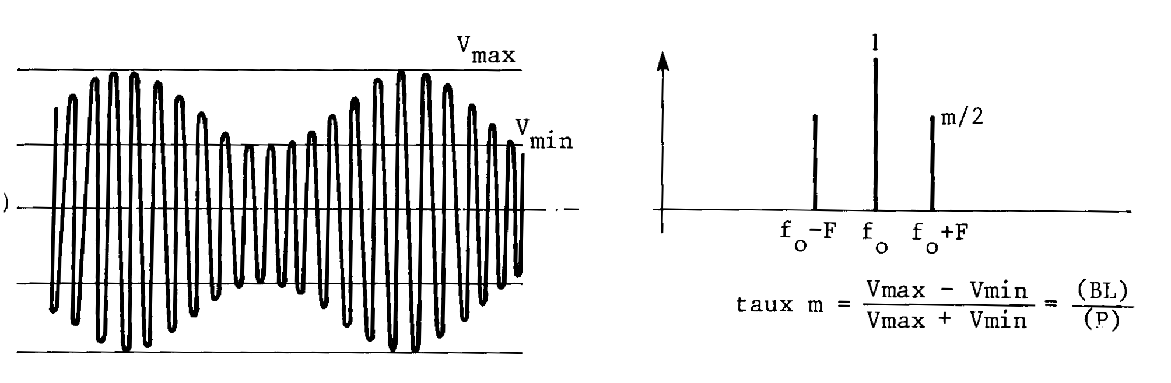
MODULATION A2A
Amplitude
Amplitude
t
f
MODULATION A2A : Sinusoidal Amplitude Modulation.
The amplitude of the carrier f0 varies according to a sine form at the rythm of the modulating signal F.
Spectrum: 2 side frequencies f0-F f0+F.
The modulation rate m shows how the carrier is dug (depth of modulation).

Slide 15
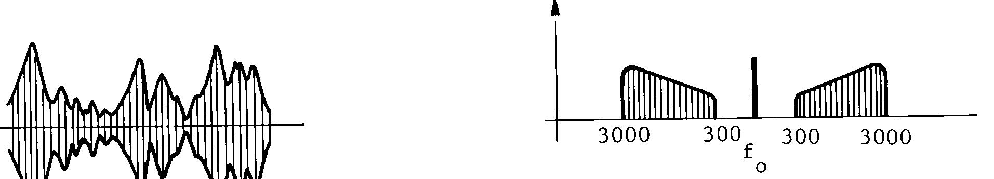
MODULATION A3E
Amplitude
Amplitude
t
f
MODULATION A3E.
The amplitude of the carrier varies according to a speech signal.
Spectrum: 2 side bands.

Slide 16
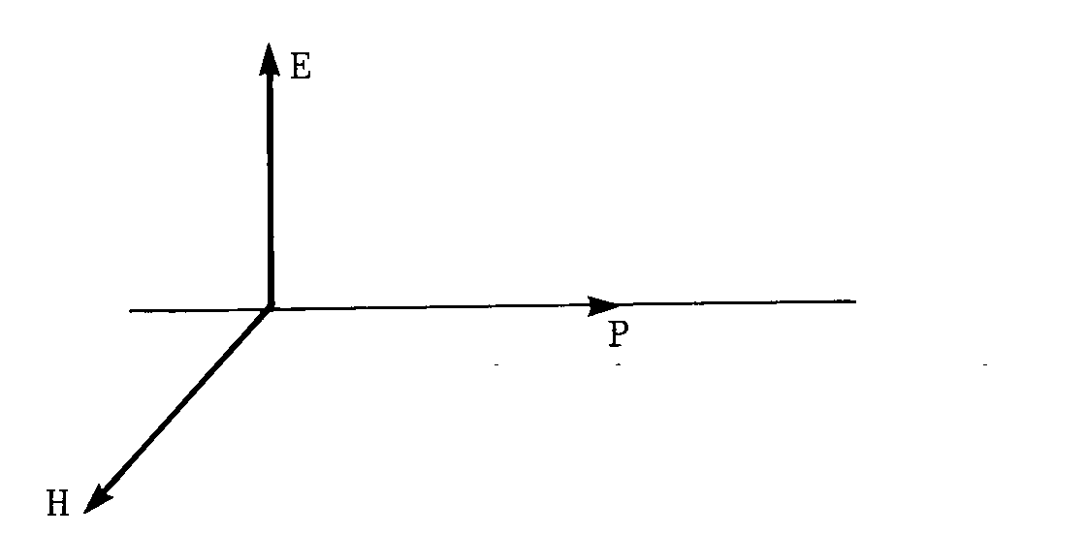
ELECTROMAGNETIC WAVE
ElectroMagnetic field: assembly of two alternating fields E and H, perpendicular to each other and perpendicular to the direction of propagation, vibrating in phase.
The theory of electromagnetic wave describes the remote effect of an alternating current flowing in a conductor. At long range this effect propagates at finite speed.It is depicted as the assembly of two fields, the electric and magnetic (E, H) fields and called the electromagnetic field.
E is expressed in V/m and H is expressed in A/m.

Slide 17
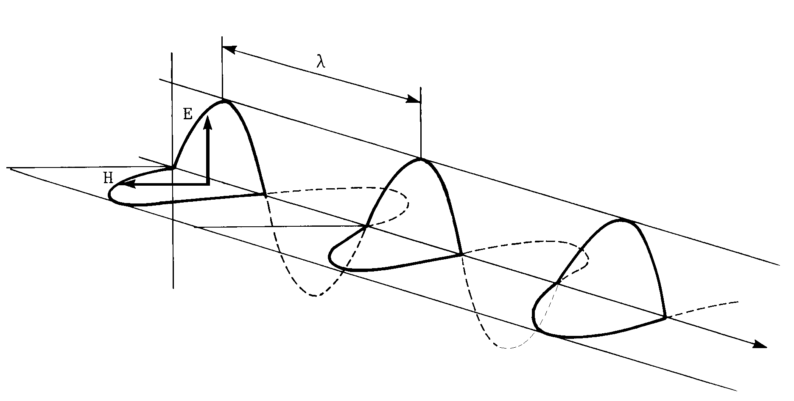
EM WAVE
Practical formula:
c = 300m/µs or 162000 Nm/s
(in free space only)
Practical formula:
lambda = 300/f
with lambda expressed in km and f expressed in KHz or
lambda expressed in m and f expressed in Mhz.
A photograph of an electromagnetic wave
1 - At a given time amplitudes are a sinusoidal function of distance with a period called wavelength. The wavelength is the distance travelled during a period of sinusoidal variation of the field.
The amplitude distribution follows the direction perpendicular to E and H, at the speed of light C.
2 - At a given point amplitude is a sinusoidal function of time.

Slide 18
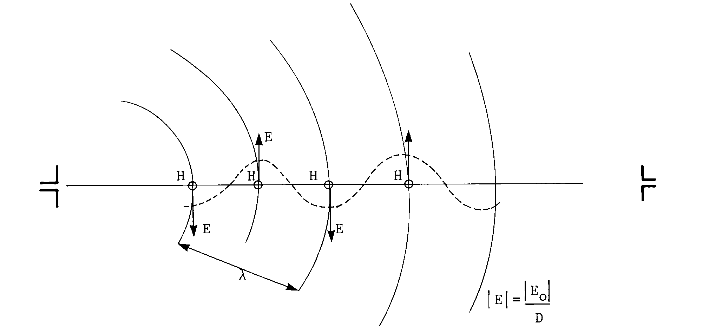
PROPAGATION

Slide 19
SPACE ATTENUATION
As the transmitted power is distributed over wave surfaces that increase as the square of the distance, the power density decreases as 1/d*d and then the amplitude decreases as 1/d. (free space). It is called the space attenuation.
A highly variable attenuation may be added to this compulsory attenuation according to the properties of the environment.

Slide 20
POLARISATION
The polarisation of EM wave describes the orientation of the plane of oscillation of the electrical component of the wave with regard to its direction of propagation.
In free space the direction of fields E and H is fixed: fields propagate parallel to themselves in two perpenpendicular planes (rectilinear polarisation)

Slide 21
PHENOMENA RELATED TO PROPAGATION
Interference
Reflection
Diffusion
Refraction
Diffraction

Slide 22
INTERFERENCE
Direct Beam
Reflected Beam
obstacle
D
R
?
Tx
R
D
Tx
ground
Very annoying -Multipaths.
Useful for Elevation patterns and for directive transmissions from a group of antennas.
INTERFERENCE: Composition of 2 coherent fields (of same frequency and fixed relative phase). The direction of the resulting field may be variable over time.
Notes:
Sssss s s

Slide 23
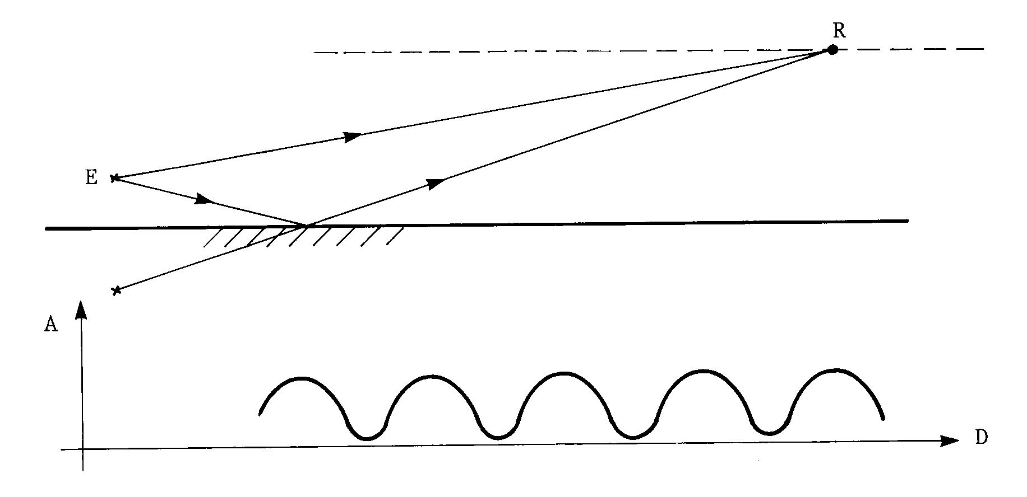
MULTI PATHS
Composition of 2 coherent fields.
Direct beam
Transmitter
Reflected beam
E-
ground
Unsteady signal

Slide 24
REFLECTION
Tx
R
Reflected beam
flat and wide target
Wide target (span is high in comparison to the wavelength) AND Flat target
(roughness is low in comparison to the wavelength)
REFLECTION: At the boundary between two media with different dielectric constants, there is occurrence of a refracted beam and a reflected beam in compliance with laws similar to the laws of optics. However polarisation must be taken in account.
Over a flat obstacle of large dimension with regard to lambda: coherent reflection.

Slide 25
DIFFUSION
Rough target
Hydrometeors: rain, hail, snow.
(Airborne Weather RADAR)
The roughness of the target
is high regarding the wave length.
Aircraft (Primary RADAR)
DIFFUSION: Over a rough obstacle (at the scale of lambda) DIFFUSION occurs: incoherent reflections to all the direction. (principle of radar).

Slide 26
REFRACTION
Ionospheric refraction
REFRACTION occurs when the radio path is bent.
Atmospheric
refraction
Tx
1 -The Ionosphere is the component of the earth’s upper atmosphere from 60 to 400 km above the surface.
Under sun radiations the upper layers of the atmosphere are ionised and refracts some frequencies: propagation occurs between two points that may be beyond line of sight by total refraction at a height ranging from 60 to 400 Km. This ionospheric wave is called SKY WAVE.(f < 30 Mhz)
2 -There’s also a refraction in the lower layer of the atmosphere.

Slide 27
IONOSPHERE
F
400 Km
E
D
By night
60 Km
LF MF
The Ionosphere is the component of the earth’s upper atmosphere from 60 to 400 km above the surface.The layers are named D,E,F and their depth varies with time. Under sun radiations these upper layers of the atmosphere are ionised and refracts some frequencies

Slide 28
STRUCTURE OF IONOSPHERE
The IONOSPHERE is the ionized component of the Earth’s upper atmosphere from 60 to 400 km above the surface.
The layers in the IONOSPHERE are named D, E and F layers and their depth varies with time.
Electromagnetic waves refracted from the E and F layers of the IONOSPHERE are called SKY waves.

Slide 29
DIFFRACTION
Direct beam
Diffracted beam
wavelength > obstacle height
DIFFRACTION: Any point of a wavefront is the source of a spherical wave (Huyghen’s principle).
The wave by-pass opaque obstacle: attenuation is high but it leaves however an exploitable field (GROUND WAVE) if the frequency is lower than 3 Mhz.

Slide 30
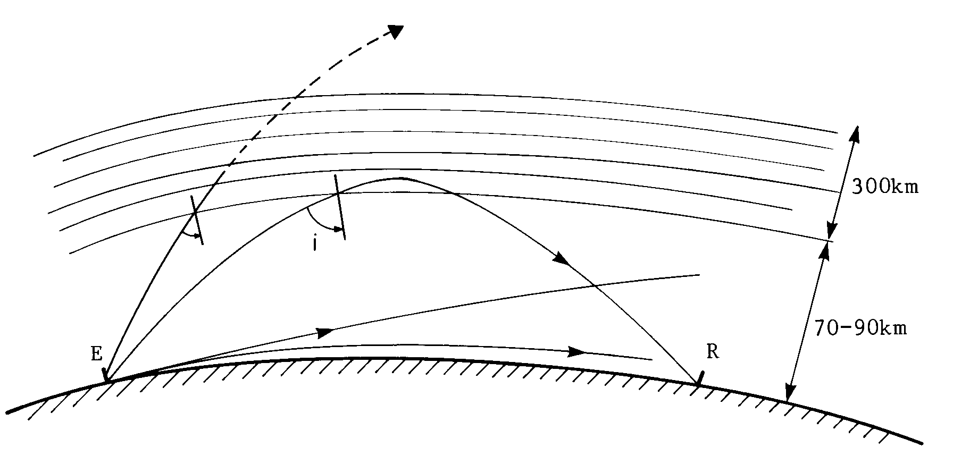
PROPAGATION PATHS
Space waves: The electromagnetic waves travelling through the air directly from the transmitter to the receiver.
Ground or Surface Waves: The electromagnetic waves travelling along the surface of the earth.
Sky waves: The electromagnetic waves refracted from the D and E layers of the ionosphere.

Slide 31
SPACE WAVE
Direct wave between two point within radio line-of-sight characterized in the atmosphere by:
Great field stability
Fixed polarisation
Reduced attenuation (close to 1/D)
The radio line-of-sight is slighty greater than the optical visibility due to the atmospheric refraction. Above a spherical earth it is related to the altitude of the transmitting and receiving antennas.

Slide 32
SKY WAVE
Under sun radiations the upper layers of the atmosphere are ionised and refracts some frequencies: propagation accurs between two points that may be beyond line of sight by total refraction at a height ranging from 60 to 400 Km. This ionospheric wave is called Sky wave.(f < 30 Mhz).
The equivalent reflection depends on frequency (easier at the lower freqencies impossible above 30 Mhz), ionisation (hour, day, season, latitude) and angle of incidence (impossible if the angle is too small hence there is a skip zone (zone of silence) for the sky wave around the transmitter.

Slide 33
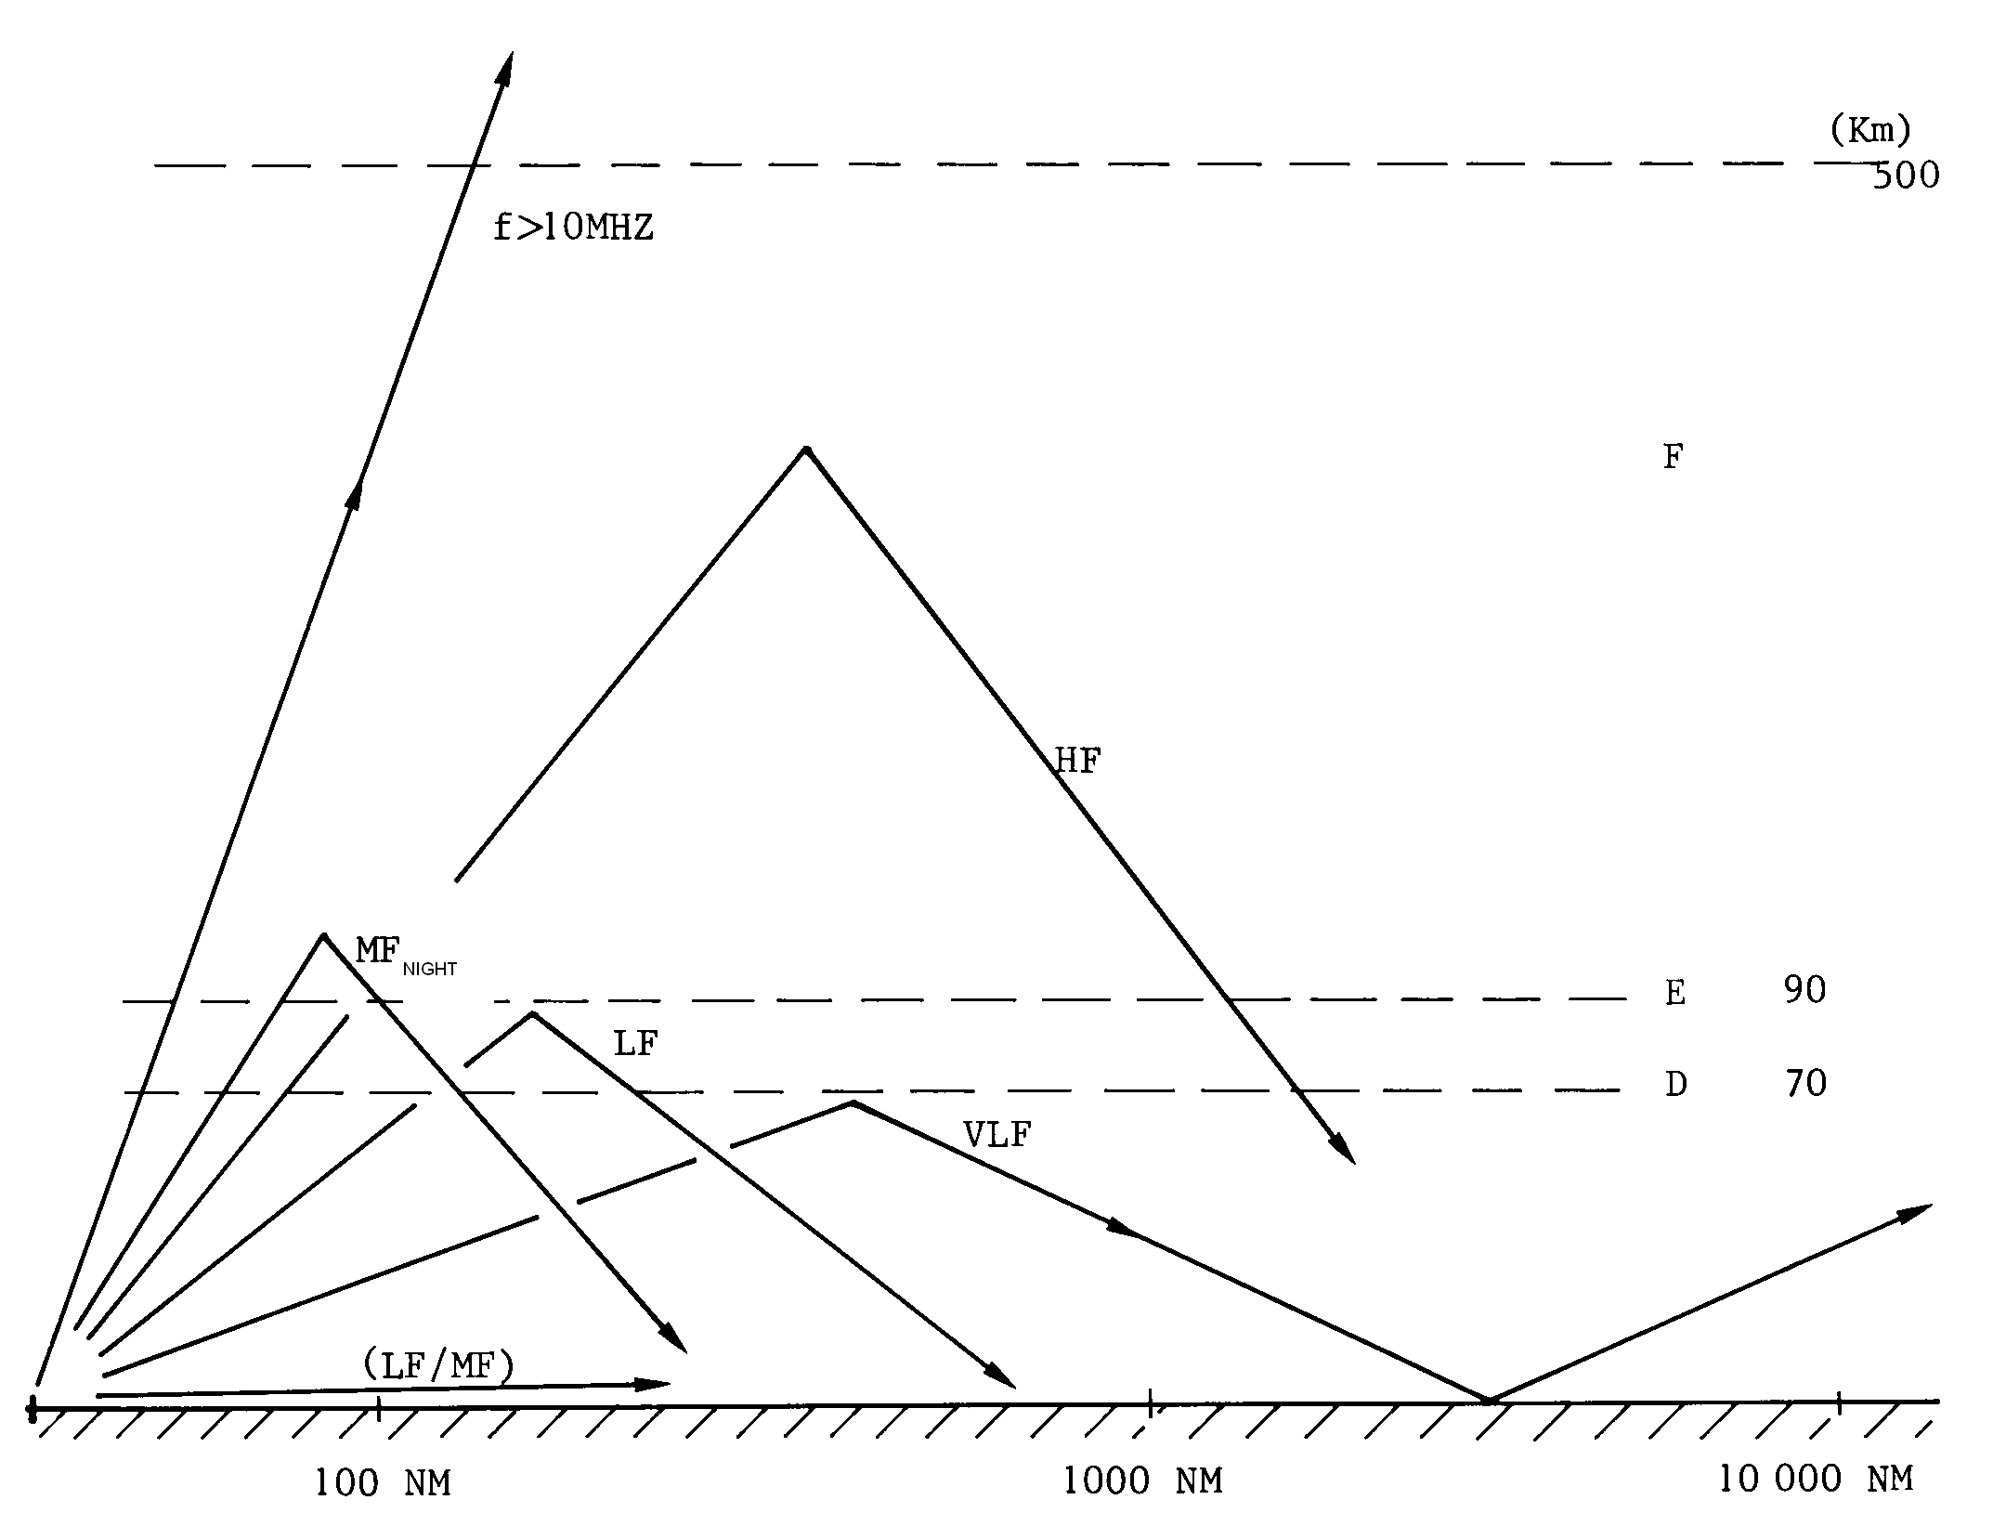
SKY AND GROUND WAVES

Slide 34
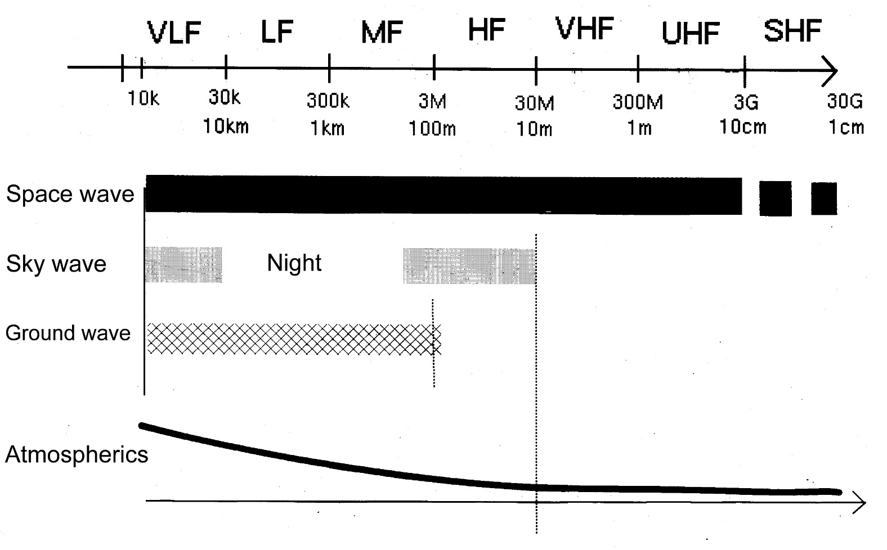
PROPAGATION TABLE

Slide 35
RADIO NOISE
We call radio noises the spurious signals, generally with broad spectrum, that superimpose to any useful signal received.
The noise is coming from:
Internal noise coming from thermal agitation
External noise coming from atmospheric electrical discharges
Electrical noises onboard the aircraft
Jammers
The SNR signal noise ratio determines the efficiency
of a radio link.

Slide 36
ATMOSPHERIC NOISE
The atmospheric interferences prevail at low frequencies and they are broad spectrum noises.
The noise power is almost negligible above 30 MHz, stronger at night than during the day (due to ionospheric propagation), stronger in equatorial area than in temperate area.

Slide 37
FACTORS AFFECTING PROPAGATION
Skip Distance: the distance between the transmitter and the point on the surface of the earth where the first sky return arrives.
Skip Zone / Dead Space: the distance between the limit of the surface wave and the sky wave.
Fading: Interference sky wave and ground wave.

Slide 38
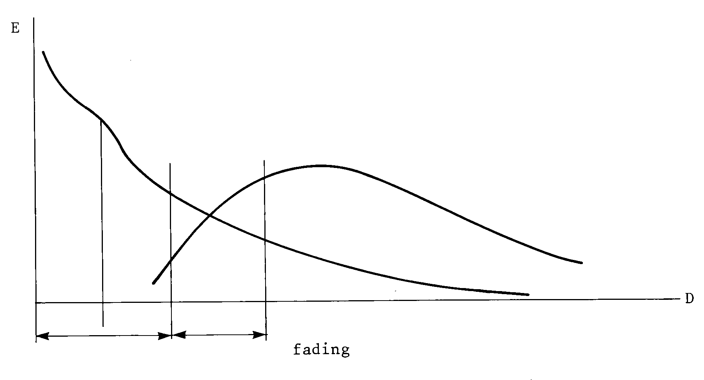
FADING
A receiver picks up the sky signal and the surface/ground signal. The signal will interfere with each other causing the signals to be cancelled out.
direct wave
ground wave
Radio line of sight
sky wave
Transmission
possible
Fading

Slide 39
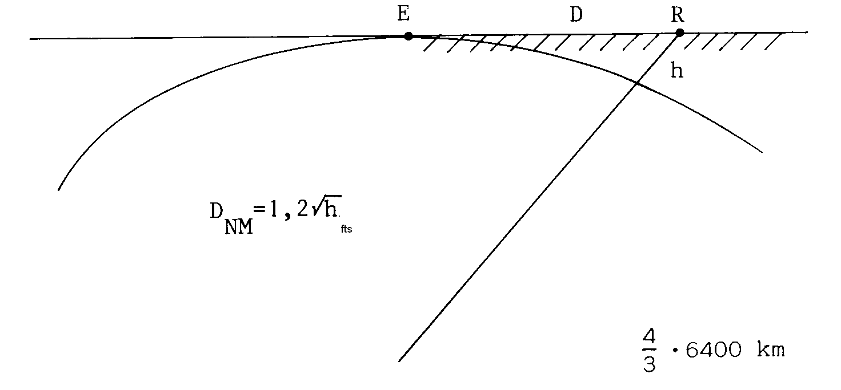
RANGE OF DIRECT WAVE
The radio line of sight (range of direct wave) is slightly greater than the optical visibility due to the atmospheric refraction.
Above a spherical earth it is related to the the altitude of the transmitting and receiving antennas.
The propagation is not straight
(atmospheric refraction).
Slight curvature.
Practical formula:
D = 1.23 * sqrt(h)
D expressed in Nm and h expressed in feet

Slide 40
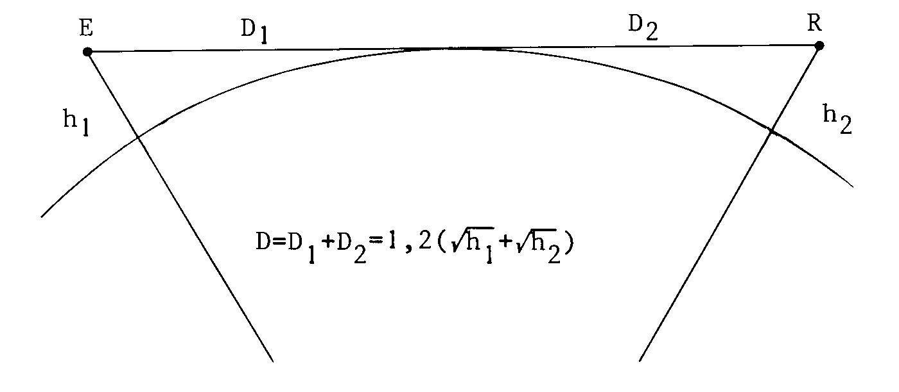
RANGE OF DIRECT WAVE

Slide 41
RANGE OF DIRECT WAVE
The radio line of sight (range of direct wave) is slightly greater than the optical visibility due to the atmospheric refraction.
Exemple1: Transmitter placed at the top of Eiffel tower.
D = 1.23 * √ (1000)
D = 39 Nm
Exemple 2: Airliner. FL 330 long-haul aircraft , FL 290 Paris Toulouse.
FL 400 executive jet.
D = 1.23 * √ (40000)
D = 240 Nm
Exemple 3: VOR located at 2500 ft and aircraft flying at 10000 Ft.
D = 1.23 * √ (2500) + 1.23 * √ (10000)
D = 184 Nm

Slide 42
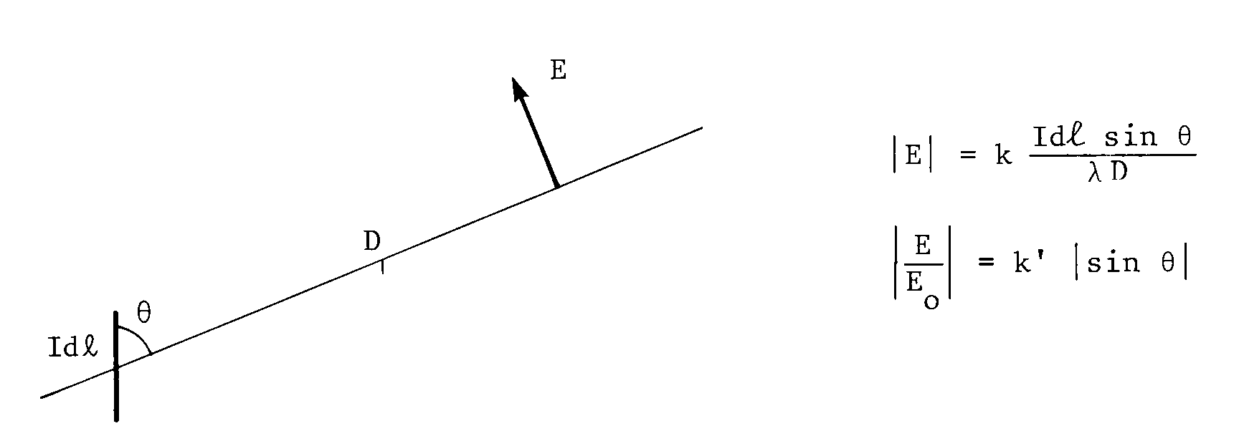
RADIATION OF AN ELEMENT OF CURRENT
An antenna is a circuit designed to transform electrical energy of a high freq
current into radiation.
An antenna is usually an open circuit connected to a transmitter or receiver. The circuit is closed by the EW.
The circuit has finite dimensions and the field radiated to space is the combination of elementary fields coming from the different sections of the circuit where the amplitude of the alternating current is known.
As a result the radiation of actual antennas is never isotropic.
A strand
(an element
of current, a tiny copper wire)

Slide 43
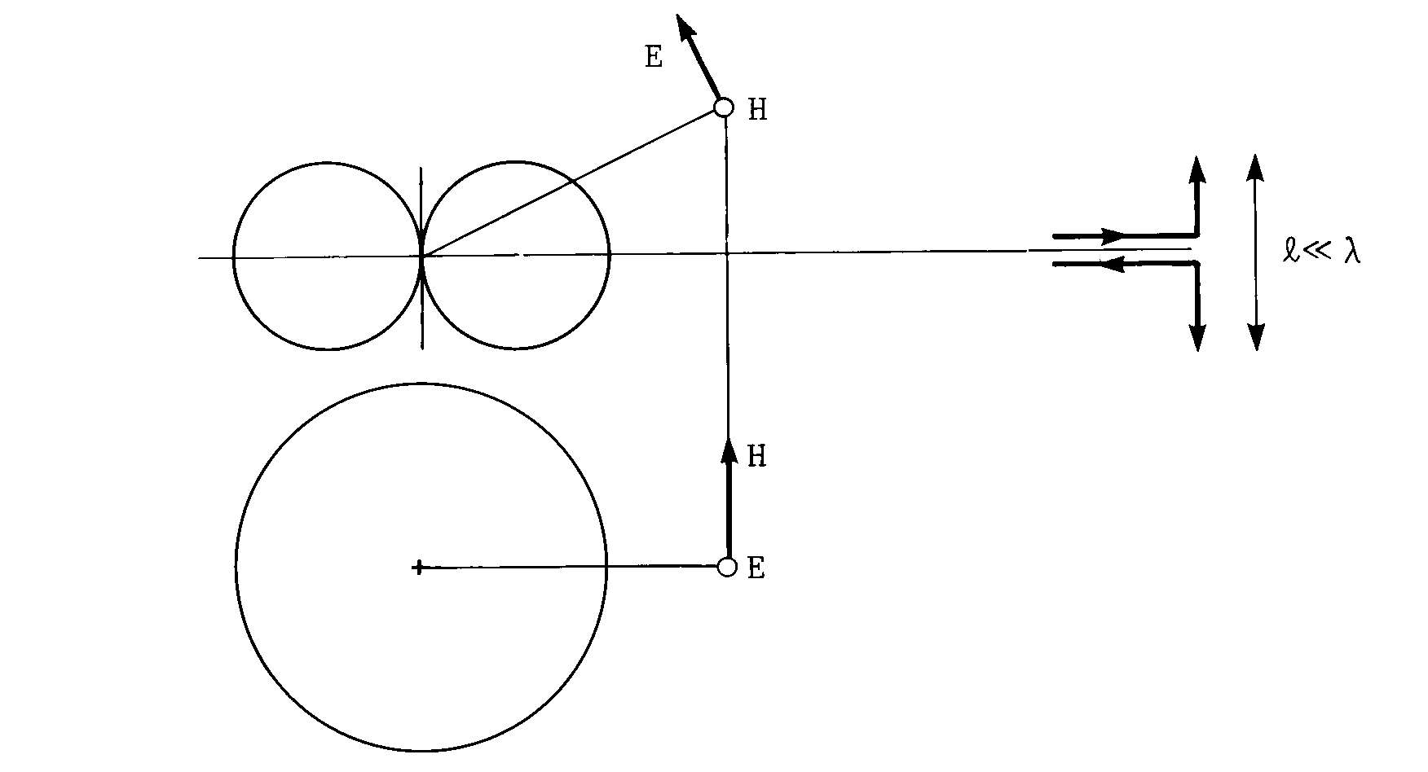
RADIATION PATTERN OF A DIPOLE
ELevation pattern
Dipole of length very low compared to lambda.
The radiation pattern is a torus of revolution whose axis is the dipole. Its cross-section is bicircular and describes the field amplitudes at a given distance.
a dipole = 2 strands
AZimuth pattern
Radiation pattern : the amplitude distribution of the E Field is plotted versus the direction. Electric modulus as a function of the direction.
The pattern is considered in vertical plane (EL pattern) and in the horizontal plane (AZ pattern), plotted in polar coordinates.

Slide 44
HALF WAVE DIPOLE ANTENNA
Standing wave
Tuned antenna:
It is intesting to generate in the antenna a state of standing current waves to increase the radiation.
The antenna is the tuned and its yield is maximal.
Progressive wave
λ/4
Line or feeder
Coaxial cable
2 electric wires
An half wave dipole antenna consists of two quater wavelength radiators.
The current and the voltage are 90° out of phase.

Slide 45
RADIATION RESISTANCE
Rr 75 Ω
LCω² = 1
A tuned antenna is equivalent to a RLC circuit, resistor coil and capacitor.
The radiated energy seems to be dissipated in a virtual resistance called radiation resistance Rr.

Slide 46
MONOPOLE ANTENNA
Metallic frame or ground
With a metallic frame or ground it is possible to remove the lower strand. Monopole antenna (quater wave antenna).

Slide 47
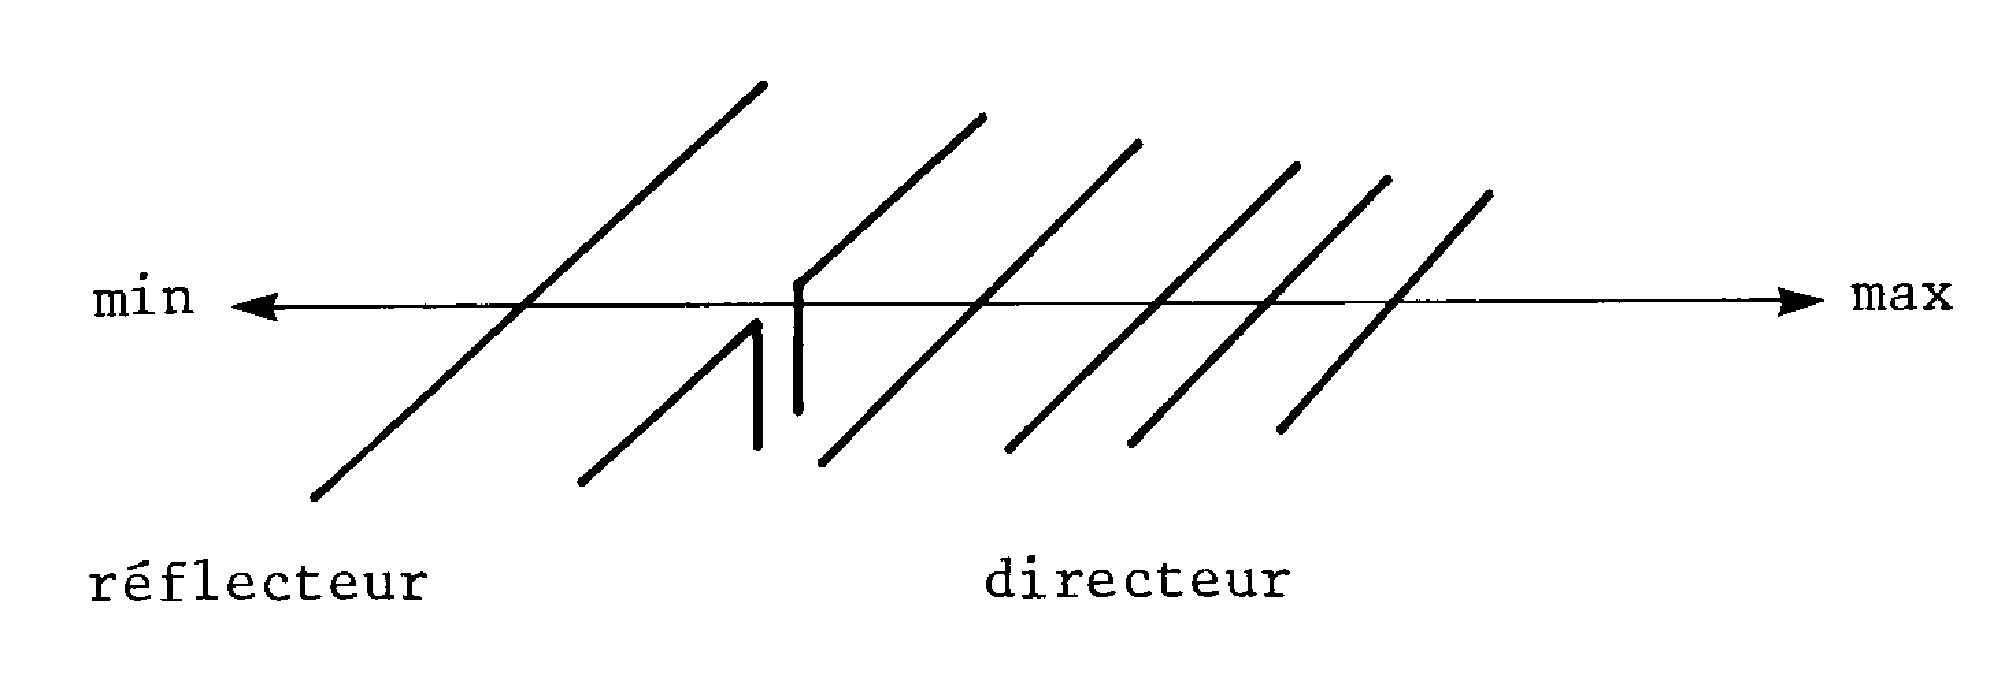
ANTENNA WITH WIRE REFLECTOR
An insulated wire acts as reflector and increase directivity.
Insulated wire in the vicinity of a radiation wire, excited by coupling and its radiation is combined with dipole.
reflector
director
YAGI Antenna.

Slide 48
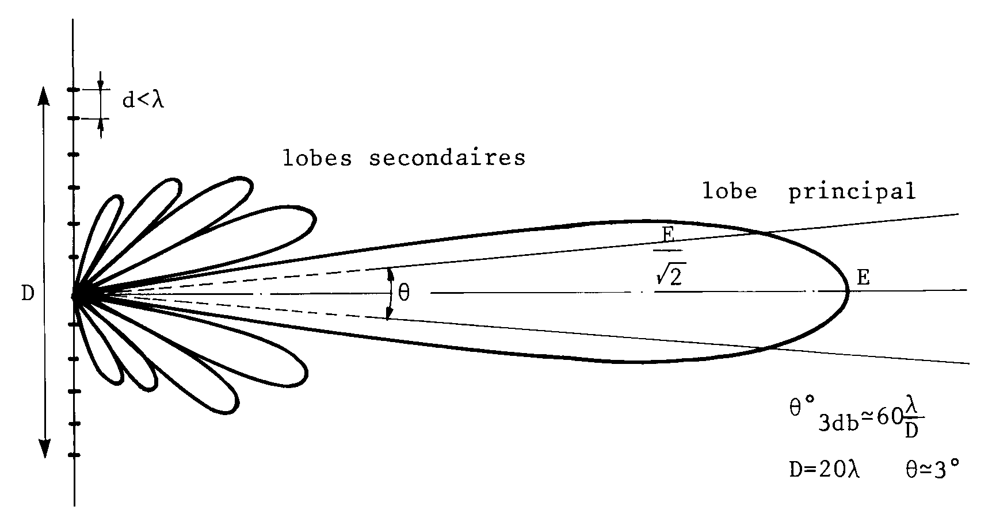
ALIGNED ANTENNAS ARRAY
Aligned antennas array. It is constituted of antennas arranged along a line and powered by defined amplitudes and phases so as to create patterns with strong directivity.
Side lobes
Major lobe
The direction of the maximal gain is generally perpendicular to the array.
The gain decreases quickly with azimuth, the pattern presents a major lobe.
Relative maxima are obtained by less favourable recombination of the fields side lobes.

Slide 49
KINDS OF DIRECTIONAL ANTENNAS
It is also possible to make a directional antennas whitout an array. It depends on frequency.
Loop antenna used in ADF receivers
Parabolic Antenna used in primary radars and weather radars (solid reflector)
Slotted planar array used in modern weather radars
Helical antenna used in GPS transmitters (shape of helix, it radiates circulary polarized radio wave)

Slide 50
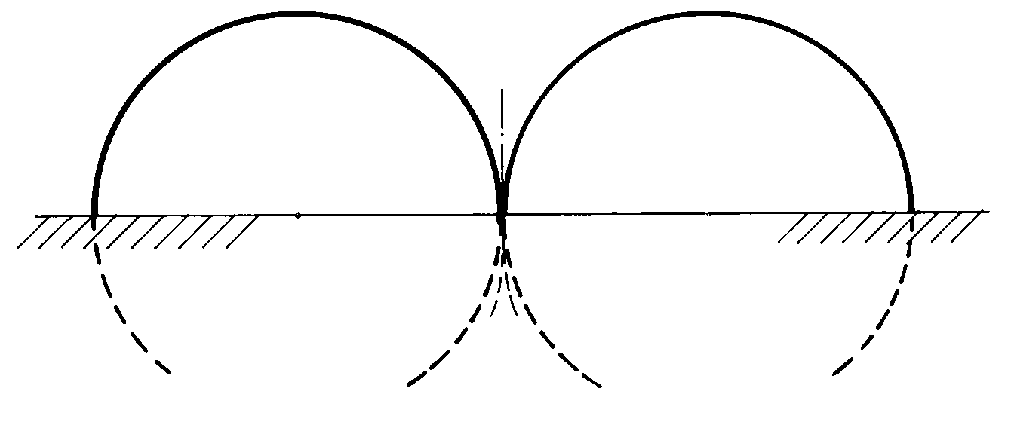
MONOPOLE WITH GROUND
Cone of silence
The radiation pattern is half a torus of revolution whose axis is the monopole antenna. Its cross-section is semi bicircular and describes the field amplitudes at a given distance.

Slide 51
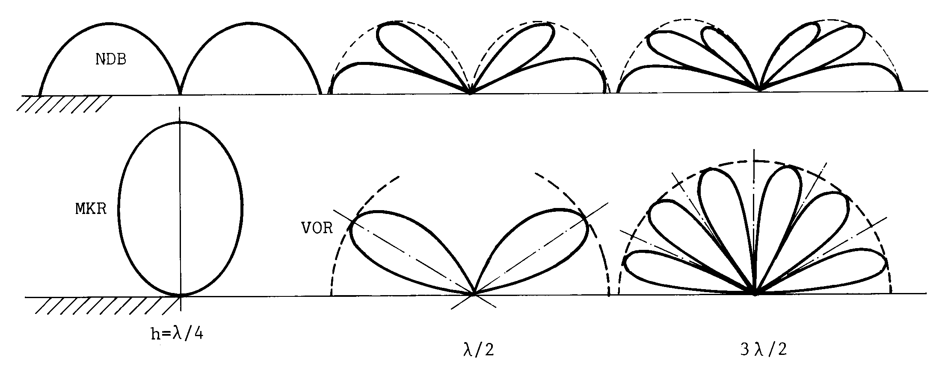
RADIATION PATTERN WITH GROUND
Vertical polarisation
Horizontal polarisation
Raising the antenna above the ground generates the foliation of ELevation patterns. This effect is exploited in radionavigation to obtain patterns that favour low elevation angles: reduced radiation with regard to obstacles. Many lobes in the pattern.

Slide 52
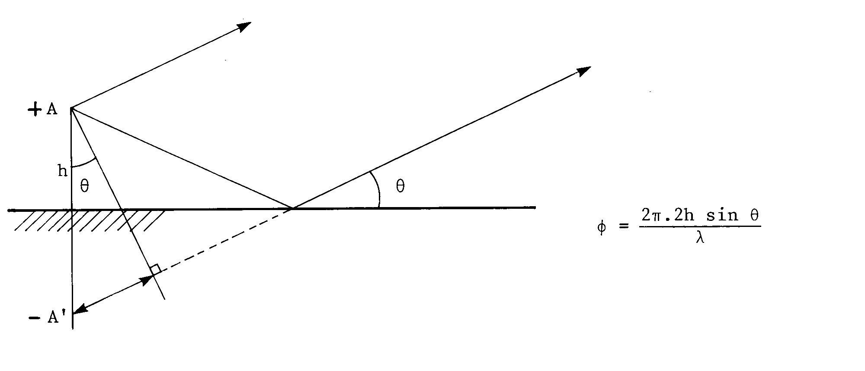
ANTENNA AND REFLECTOR
Direct beam
Reflected beam
real antenna
Ground or reflector
Phase difference
Path difference
dummy antenna

